Slide 1
Nonlinear Models and Bootstrapping
Dr. Sparkle Malone
Florida International University
Malone Disturbance Ecology Lab

Slide 2
Objective
Understand the basics of nonlinear modeling
Fit light and temperature response curves.
Understand annual patterns in photosynthetic efficiency and ecosystem respiration temperature sensitivity.
Create a workflow to measure changes in monthly parameters for Harvard forest.

Slide 3
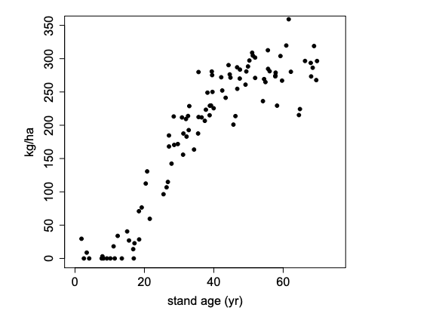
Estimate the response variable with good accuracy
Primary Objective
The goal of both linear and non-linear regression is to adjust the model parameters to find the line or curve that comes closest to your data.
The nonlinear model theory is derived from the classical linear model.

Slide 4
Least Square Regression
The nonlinear model relies on a nonlinear least-squares (NLS) estimator for the estimation of the parameters.
The best model is assumed to be that which minimizes the sum of the squares of the vertical distances of different points from the regression curve.
It must be found iteratively
https://www.tutorialspoint.com/r/r_nonlinear_least_square.htm

Slide 5
Non Linear Regression
We generally start with a defined model and assume some values for the coefficients. We then apply the nls() function in R to get more accurate values along with the confidence intervals.

Slide 6
Assumptions
1. Error terms are normally distributed.
2. Error variances are homogeneous.
3. The error terms are independent.

Slide 7
Evaluating Assumptions
Normality: Histogram of the residuals.
Homogeneous variance: Investigated using a scatter plot between the residual and predicted response variable.
Residual mean: You want residuals close to zero.

Slide 8
Evaluating Assumptions
Independence: The assumption of independence can be invalidated in cases of repeated measurements, clustered measurements (e.g. trees nested in plots), longitudinal data (e.g. repeated measurements on the same trees).
As a result of high autocorrelation, the standard errors of parameter estimates from these models are artificially small, and statistical tests are not valid. Therefore, analysis are presented in a descriptive context.

Slide 9
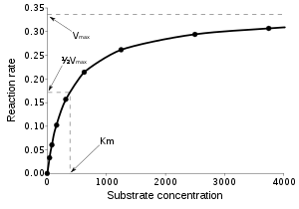
Non-Linear Regression
A nice feature of non-linear regression in an applied context is that the estimated parameters have a clear interpretation
(Vmax in a Michaelis-Menten model is the maximum rate) which would be harder to get using linear models on transformed data for example.
Hertzog 2016: https://www.r-bloggers.com/first-steps-with-non-linear-regression-in-r/

Slide 10
Starting Values
Finding good starting values is very important to allow the model algorithm to converge.
If you set starting parameters values completely outside of the range of potential parameter values the algorithm will either fail or it will return non-sensical parameter estimates.

Slide 11
Starting Values
One way to find starting value is to “eyeball” the data, plotting them and based on the understanding that you have from the equation find approximate starting values for the parameters.

Slide 12
Self-Starting Functions
Nonlinear least squares method becomes insufficient because the initial guesses by users for the starting parameter values may be wrong. The simplest solution is to use R’s self-starting models.
selfStart()
https://stat.ethz.ch/R-manual/R-patched/library/stats/html/selfStart.html

Slide 13
Bootstrapping
These distributions were then checked to ensure that the model parameters derived from the original data were contained within a 95% confidence region.
Synthetic data generation and determination of parameter distribution
Synthetic data sets are generated by randomly selecting n observations with replacement from the original data.
Constructed the distribution of each model parameter
Checked to ensure that parameters derived from the original data are contained within a 95% confidence region.
https://data-flair.training/blogs/bootstrapping-in-r/

Slide 14
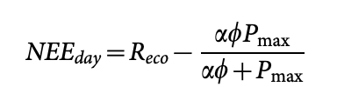

Michaelis-Menton Approach
Arrhenius Approach

Slide 15
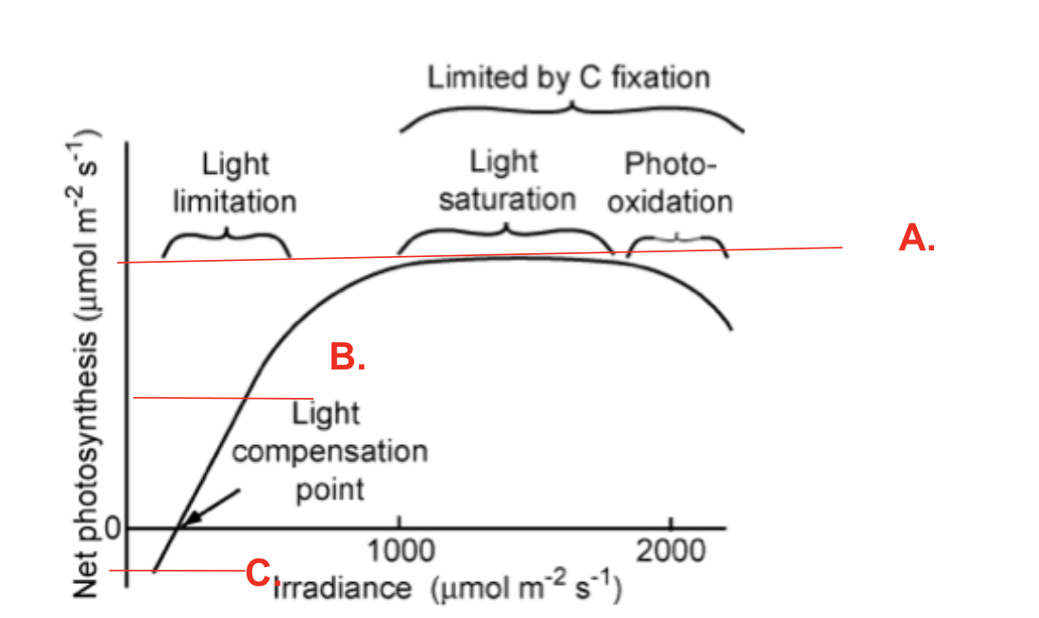
Michaelis-Menten Approach
Light Response Curves

Slide 16
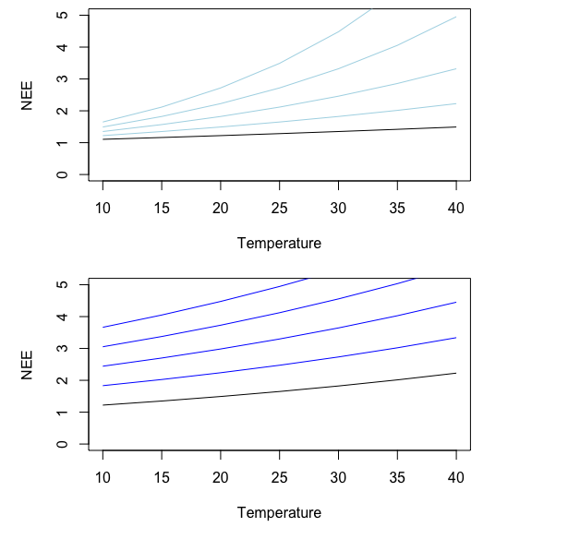
Arrhenius Approach
b=0.05
b=0.04
b=0.03
b=0.02
R₀ = 1, b=0.01
R₀ = 3
R₀ =2.5
R₀ =2
R₀ =1.5
R₀ = 1, b=0.01

Slide 17
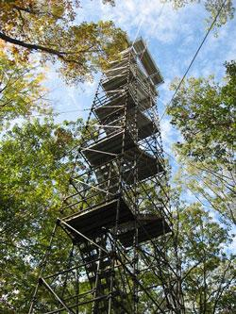
Study Site: Harvard Forest
Deciduous Forest
Location: Massachusetts
Climate: Cool, moist temperate July mean temperature 20°C January mean temperature -7°C; Annual mean precipitation 110 cm, distributed fairly evenly throughout the year
Vegetation: Transition Hardwood - White Pine - Hemlock Region
Dominant species: Red oak (Quercus rubra) Red maple (Acer rubrum) Black birch (Betula lenta) White pine (Pinus strobus) Eastern hemlock (Tsuga canadensis)
Latitude: 42.53
Longitude: -72.19
Elevation: 330
Environmental Measurement Station Eddy Flux Tower (EMS)

Slide 18

Getting Started with Nonlinear Models in R
Exercise 1
library(nlstools)
nls()
selfStart()
nlsBoot()

Slide 19
Workflow
Exercise 2
Identify your objectives and the steps you need to take to reach your final objective.
Make a plan.
Select the packages you will use for implementing the plan.
Document your work at every stage.
Make your entire workflow as reproducible as possible.

Slide 20
Challenge
Hint:

